Slide 1
How to Schedule a Program or Script in Windows -7
---Vish Mishra
http://www.learnexcelmacro.com

Slide 2
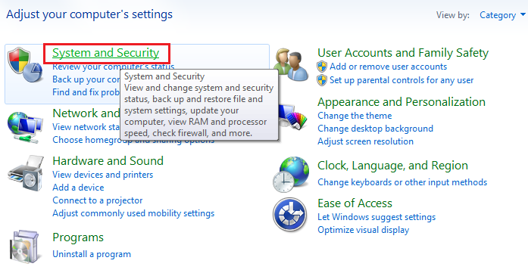
How to Schedule a Task in Windows
Go to Control Panel of your System
Click on System and Security

Slide 3
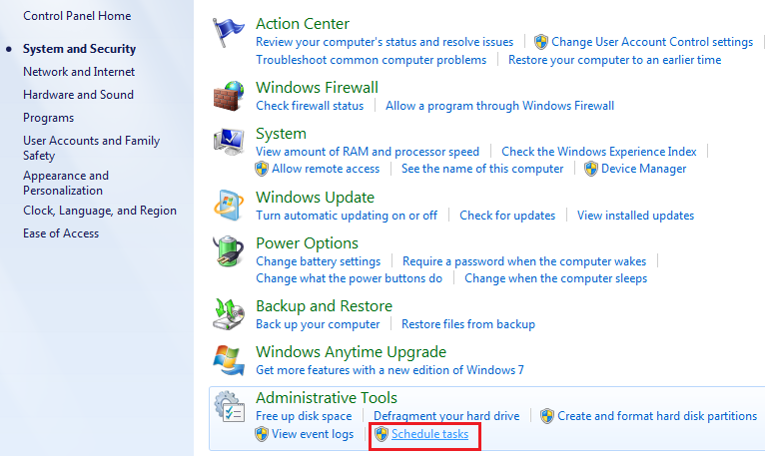
How to Schedule a Task in Windows
Click on Schedule Task in Administrative Tools.

Slide 4
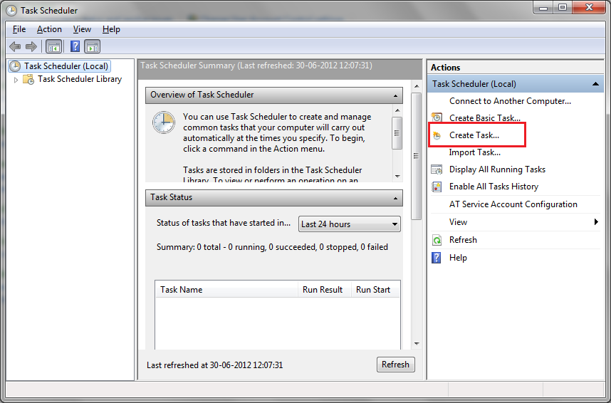
How to Schedule a Task in Windows
Click on Create Task…

Slide 5
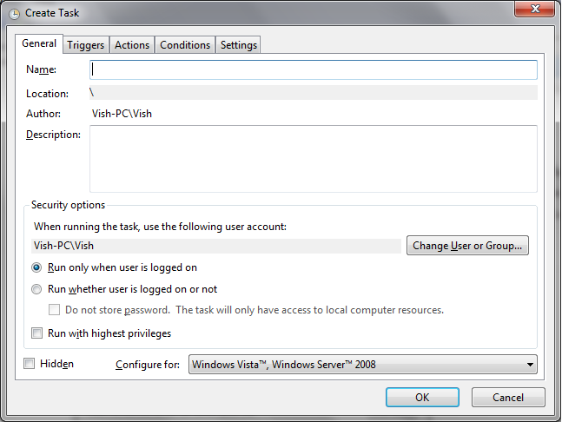
How to Schedule a Task in Windows
Enter Name and Description of Task you want to Schedule
Select the Security options Appropriately
Click Ok

Slide 6
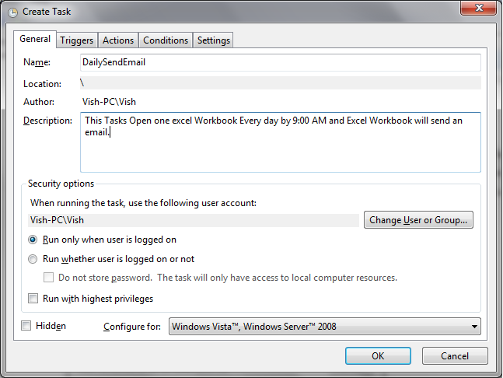
How to Schedule a Task in Windows
Enter Name and Description of Task you want to Schedule
Select the Security options Appropriately
Click Ok

Slide 7
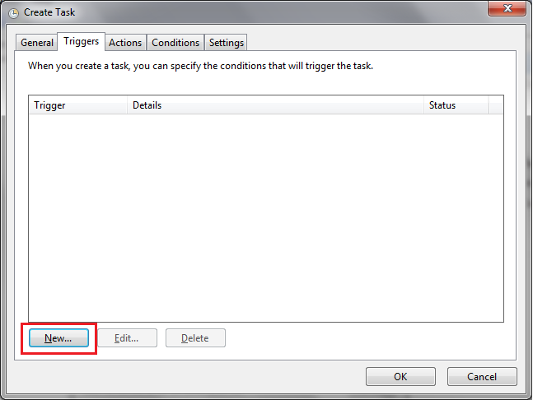
How to Schedule a Task in Windows
Go to Triggers Tab
Click on New

Slide 8
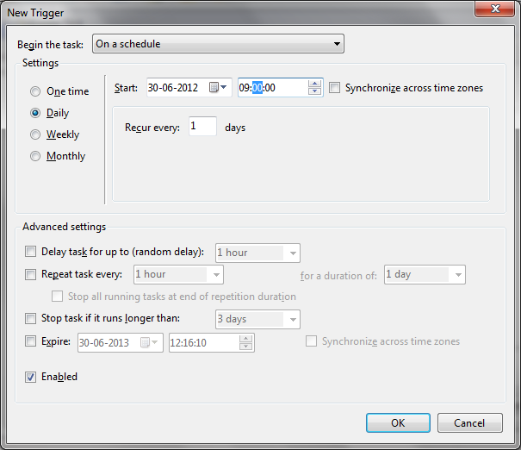
How to Schedule a Task in Windows
Set the appropriate Schedule as per your requirement.
For Example: here I have scheduled for Daily 9:00 AM from 30th June.
You can also do some advanced settings in Advanced Settings Section below.
Check the Enabled Check Box to make the Task Enabled and Click OK

Slide 9
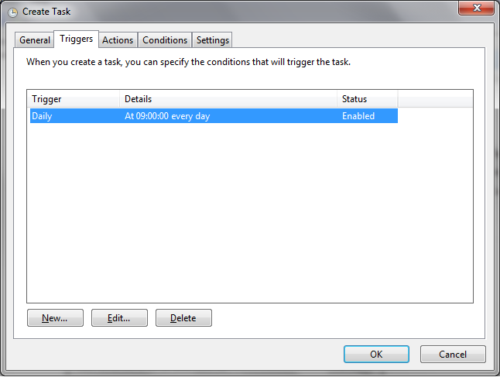
How to Schedule a Task in Windows
Schedule is Added here as shown below

Slide 10
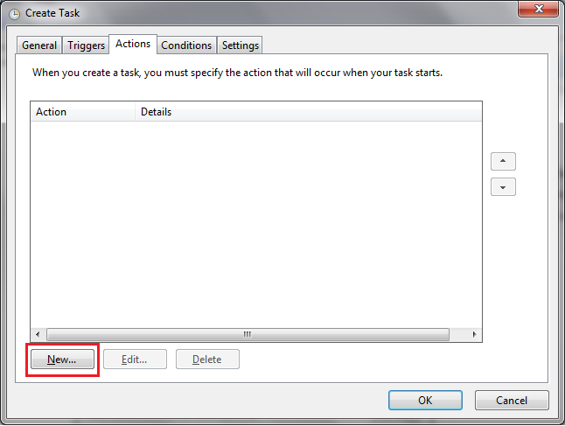
How to Schedule a Task in Windows
Go to Action Tab
Click on New

Slide 11
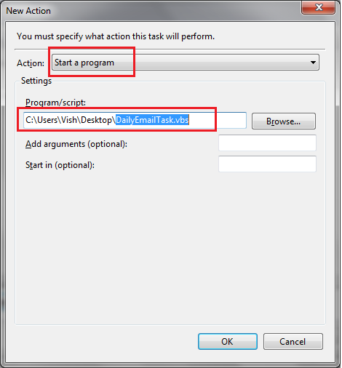
How to Schedule a Task in Windows
Select “Start a Program” from Action Drop Down
Browse your File or Script file from your Local System.
For Example: I have selected one VB Script File.
Click OK

Slide 12
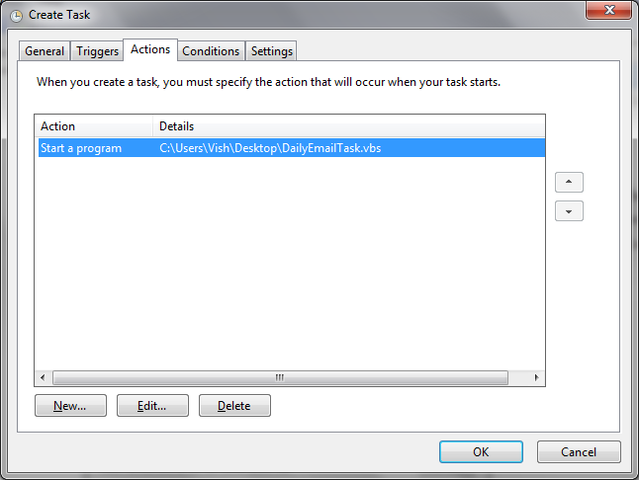
How to Schedule a Task in Windows
One Action is Added
Click OK

Slide 13
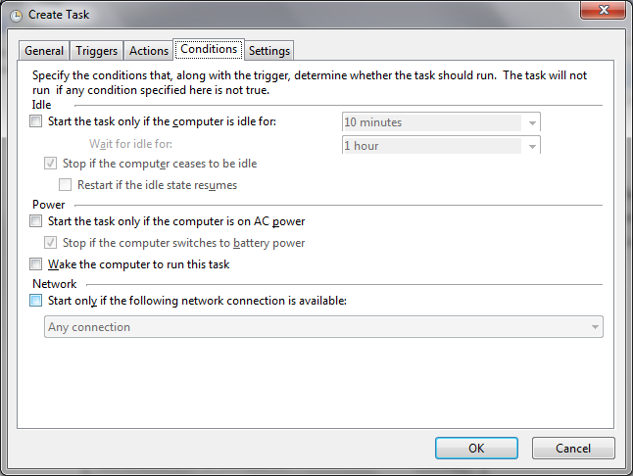
How to Schedule a Task in Windows
Go to Condition Tab
You can select any of the option as per your requirement.

Slide 14
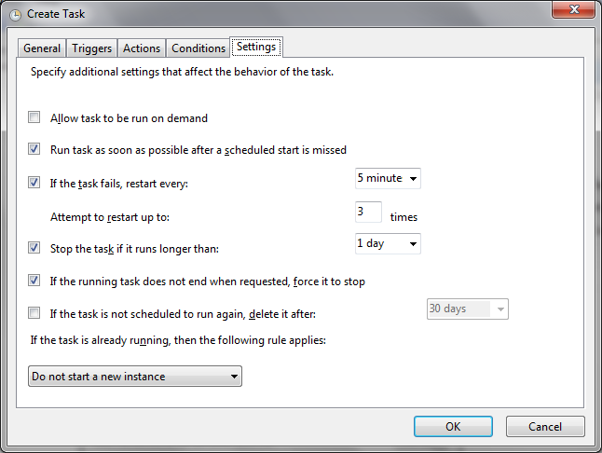
How to Schedule a Task in Windows
Go to Settings Tab
Select appropriate Option as per your requirement.
Click OK

Slide 15
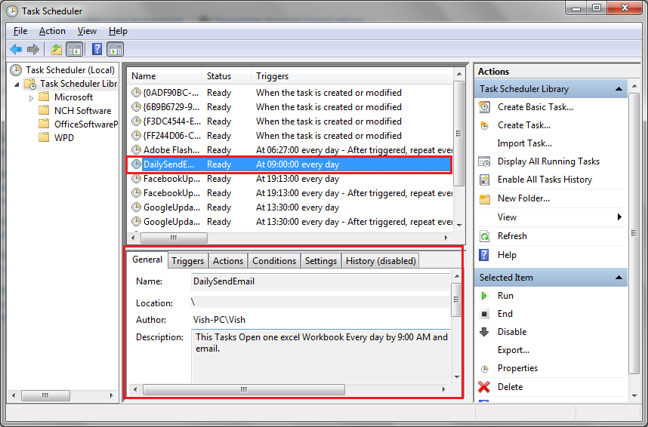
How to Schedule a Task in Windows
And you are done. Your Task is Scheduled.

Slide 16
Thank You ☺
Any Question related to Scheduling?
Any Question to Excel Macro?
Mail me @ Info@LearnExcelMacro.Com
Or Login to my blog: http://www,learnexcelmacro.com

